Slide 1

Contactless Fare Payment Review
Hannah DeBruin
Weekly Meeting: Transit Data Subgroup
10/05/22

Slide 2
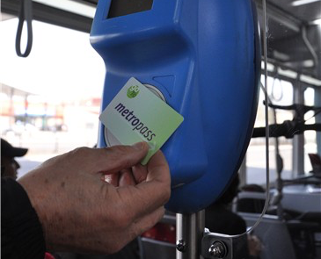
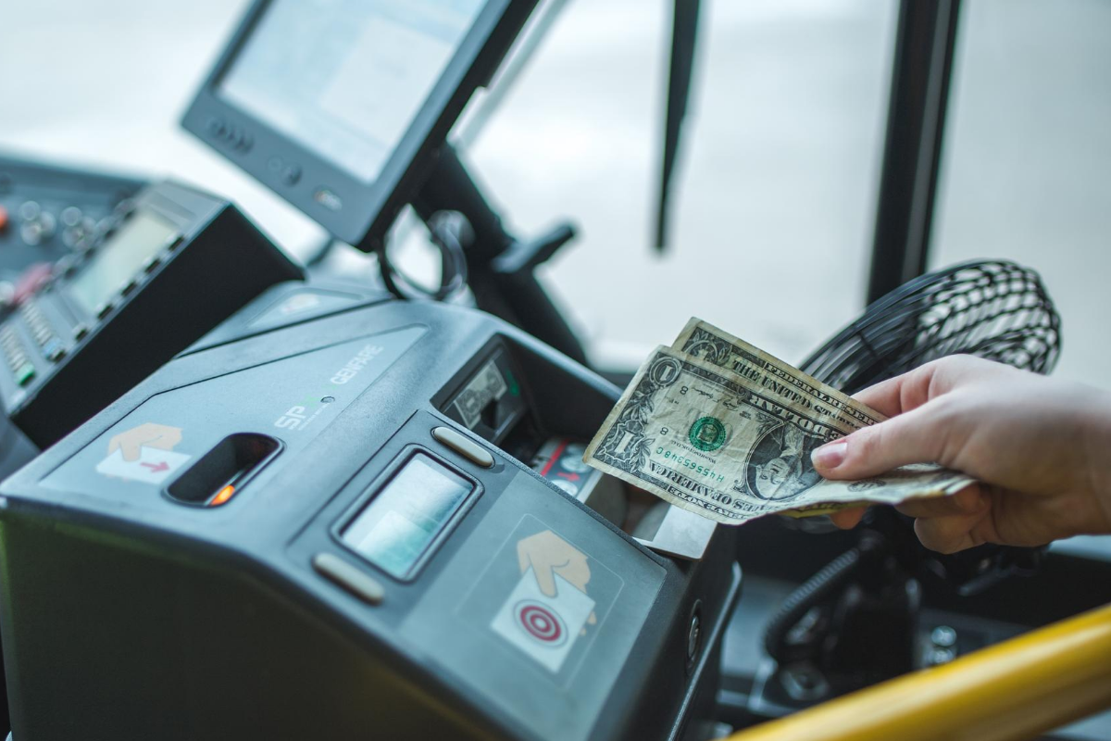
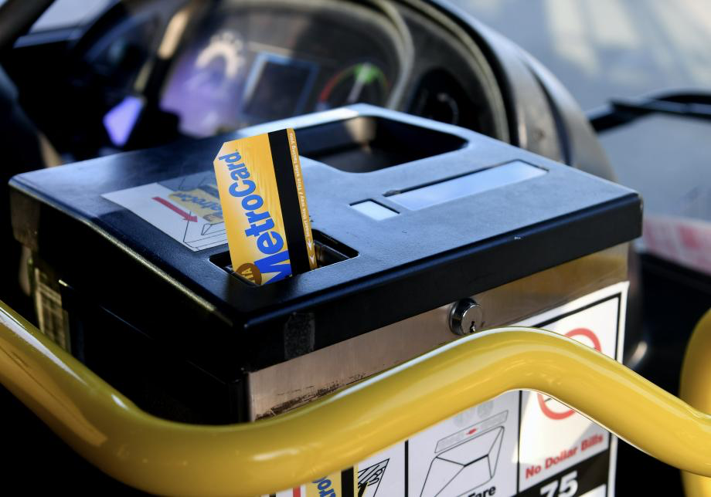
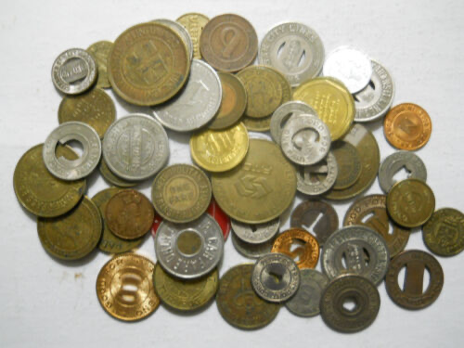
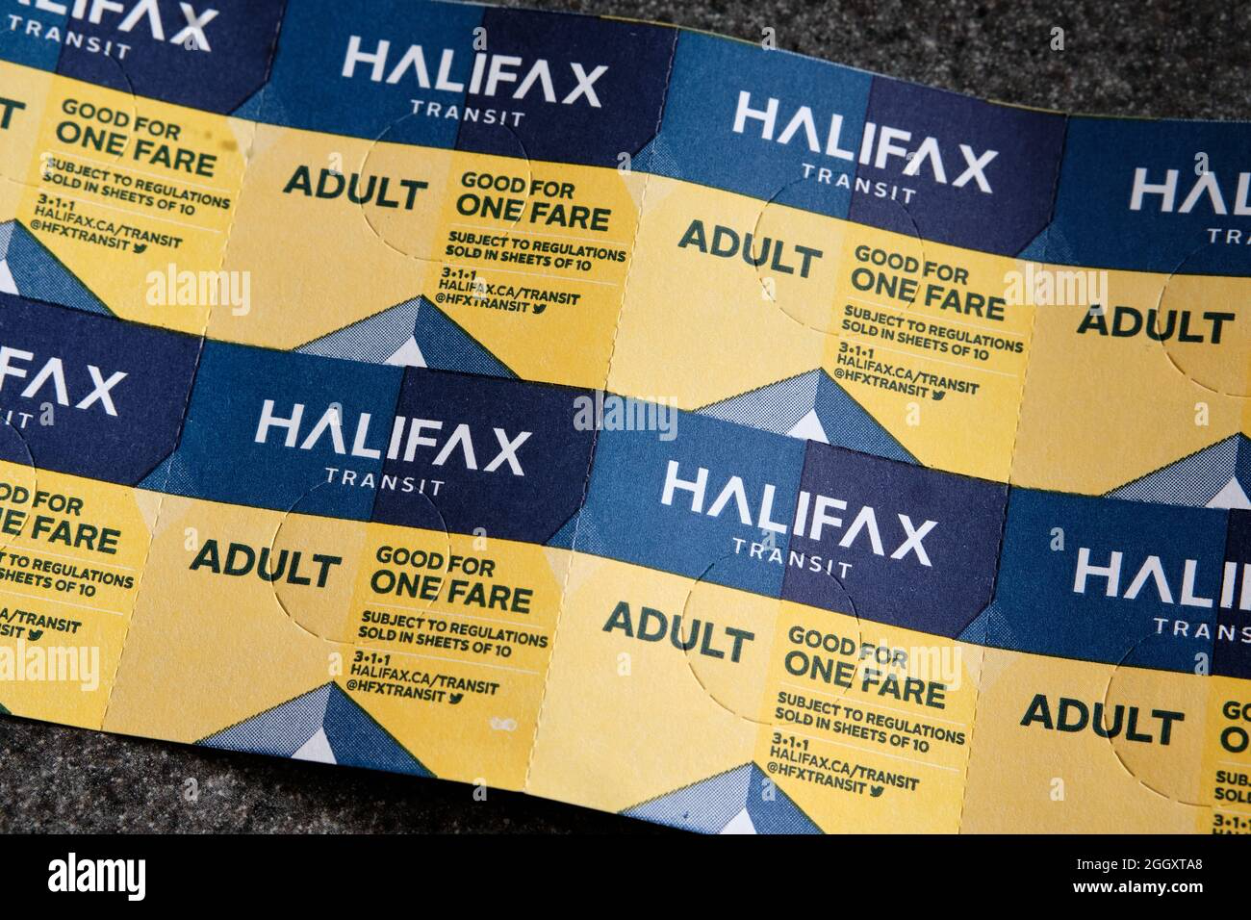
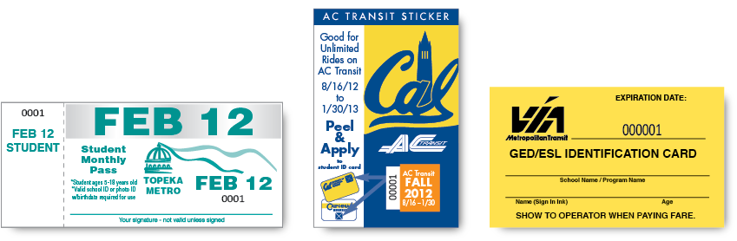
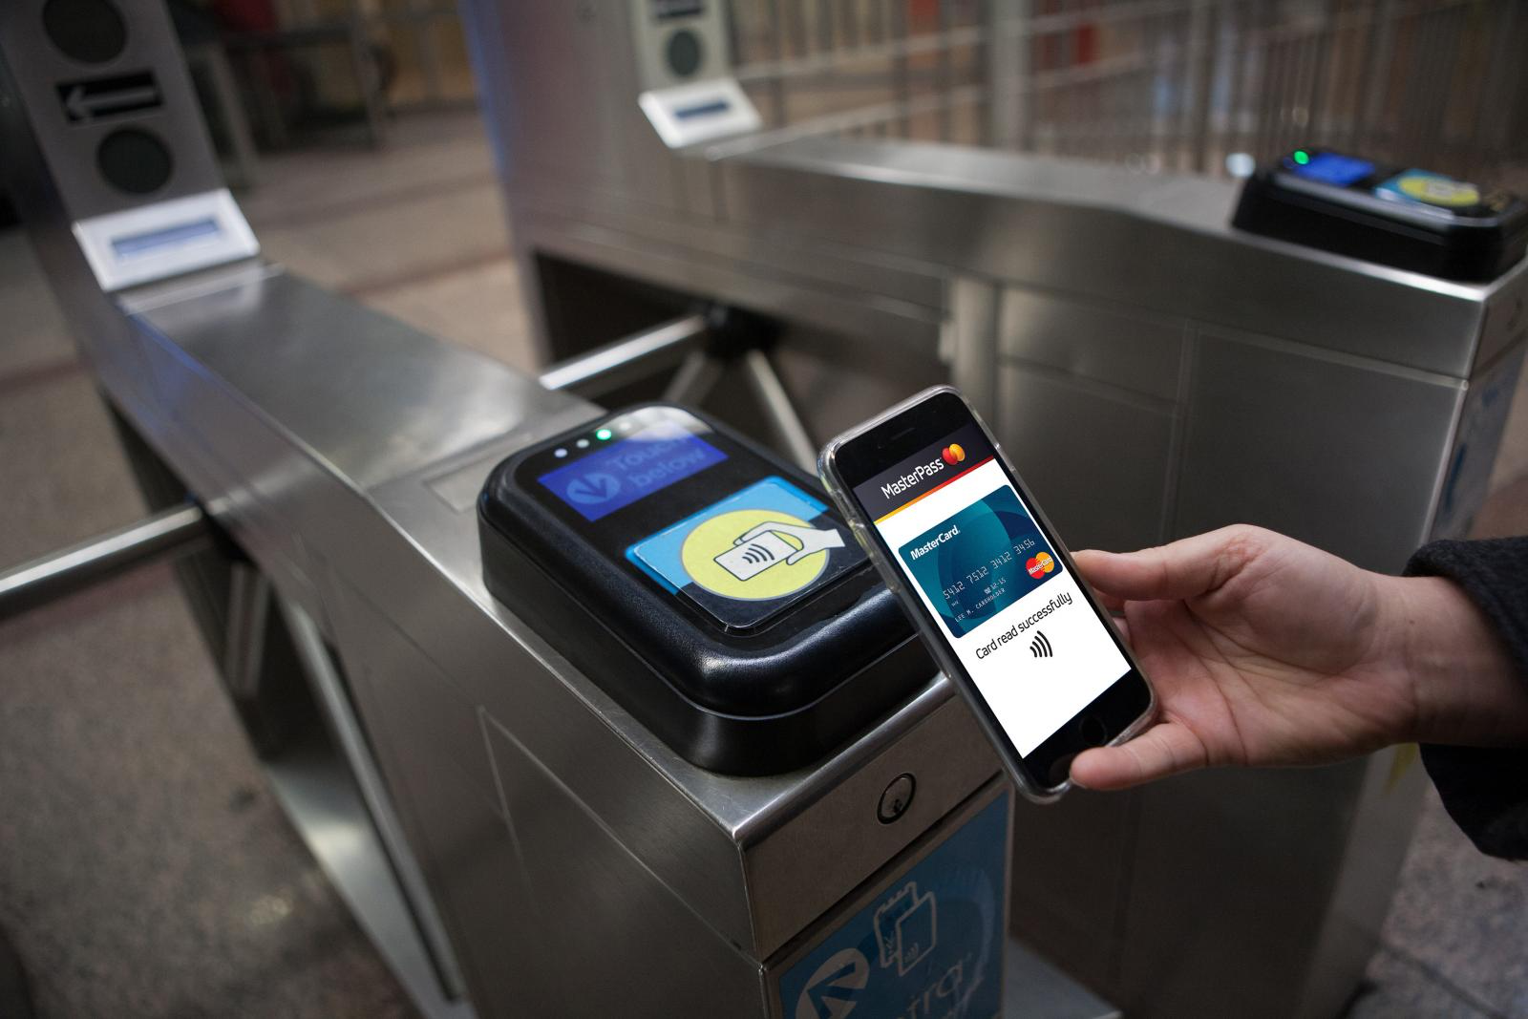
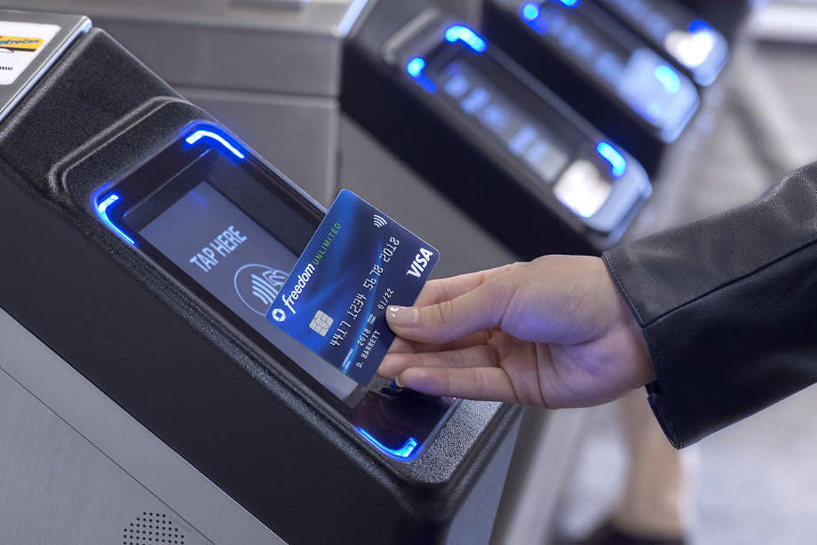
Fare Payment Types
Transit-Issued Smart Cards
Cash (Currency Exchange)
Magnetic Stripe Cards
Tokens/Fare Booklet
Tickets
Bank Cards
Digital Wallet (NFC)
Weekly Meeting (10/03/2022)
Hannah DeBruin

Slide 3
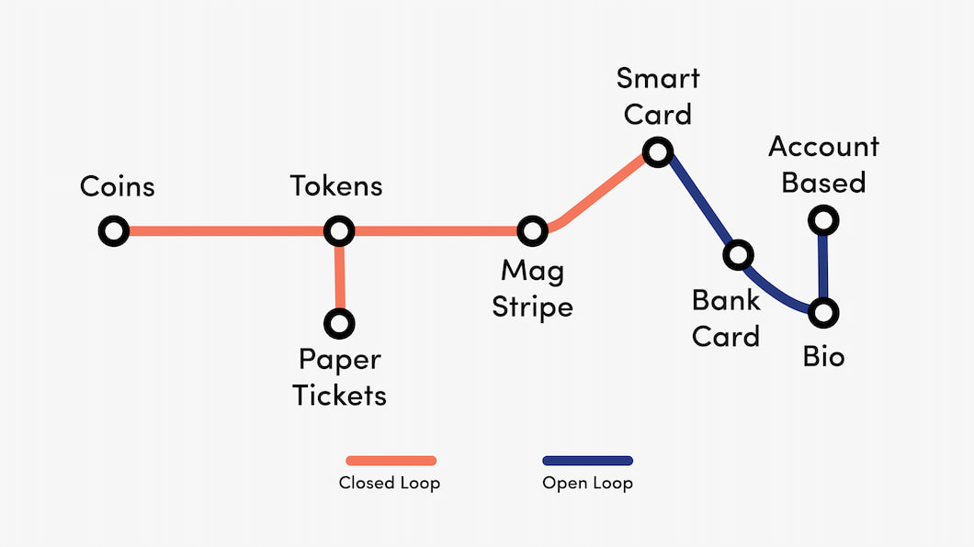
Fare Payment Types – Open v Closed Loop
Closed Loop – issued by a single organization, only used to pay for services provided by that organization. Prepaid amount must exist, user has to maintain balance. (Gift Card)
Open Loop – can use at several locations, doesn’t required a prepaid amount to exist (Credit Card)
https://www.paymentgenes.com/blog/how-to-simplify-maas-with-an-open-loop-payment-system
Weekly Meeting (10/03/2022)
Hannah DeBruin

Slide 4
Benefits of Contactless Fare Payment
Increased passenger convenience, satisfaction
Improved agency efficiency with fare collection, trip data collection
Improved route efficiency (faster boarding, less dwell time)
Seamless transfers between modes/transit providers
Can allow for “fare capping” or other policies that require the tracking of a single user’s fare payment history
Can allow for integrated trip planning and payment in one app/website
“According to a 2013 Accenture global survey of public transit users, 80% of US transit riders indicated they would be willing to pay more per ride for a completely paperless journey, while over 75% said they would pay more if they could use their smartphones for ticketing."
Weekly Meeting (10/03/2022)
Hannah DeBruin

Slide 5
Rural Contactless Fare Payment
Small agencies typically don’t have monetary and technical resources to implement expensive smart card systems provided by major suppliers
May lack staff to perform regular maintenance on card readers, maintain account databases, and operate payment
May lack resources to inform/train the public on new fare payment methods available and encourage switch
Challenge of “unbanked” riders, which are more prevalent in rural areas
Challenge of riders without smartphones, internet access, tech savvy
Weekly Meeting (10/03/2022)
Hannah DeBruin

Slide 6
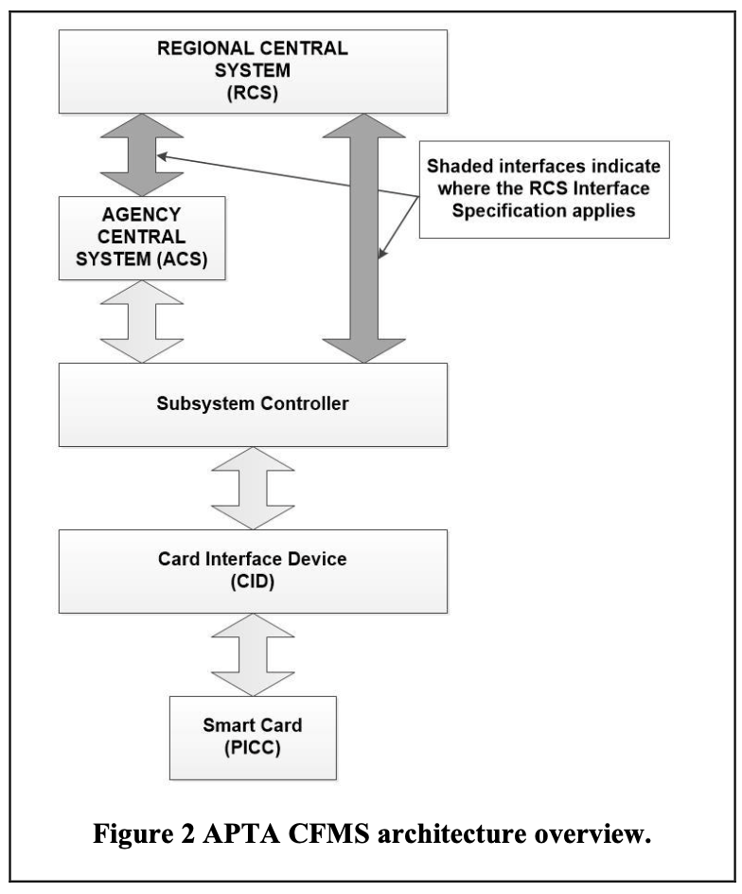
APTA Contactless Fare Media System (CFMS) Standard
Created in 2003
Specifies interface between smart card and reader, local equipment and back-office fare collection data system
Standards = greater interoperability among agencies
Weekly Meeting (10/03/2022)
Hannah DeBruin

Slide 7
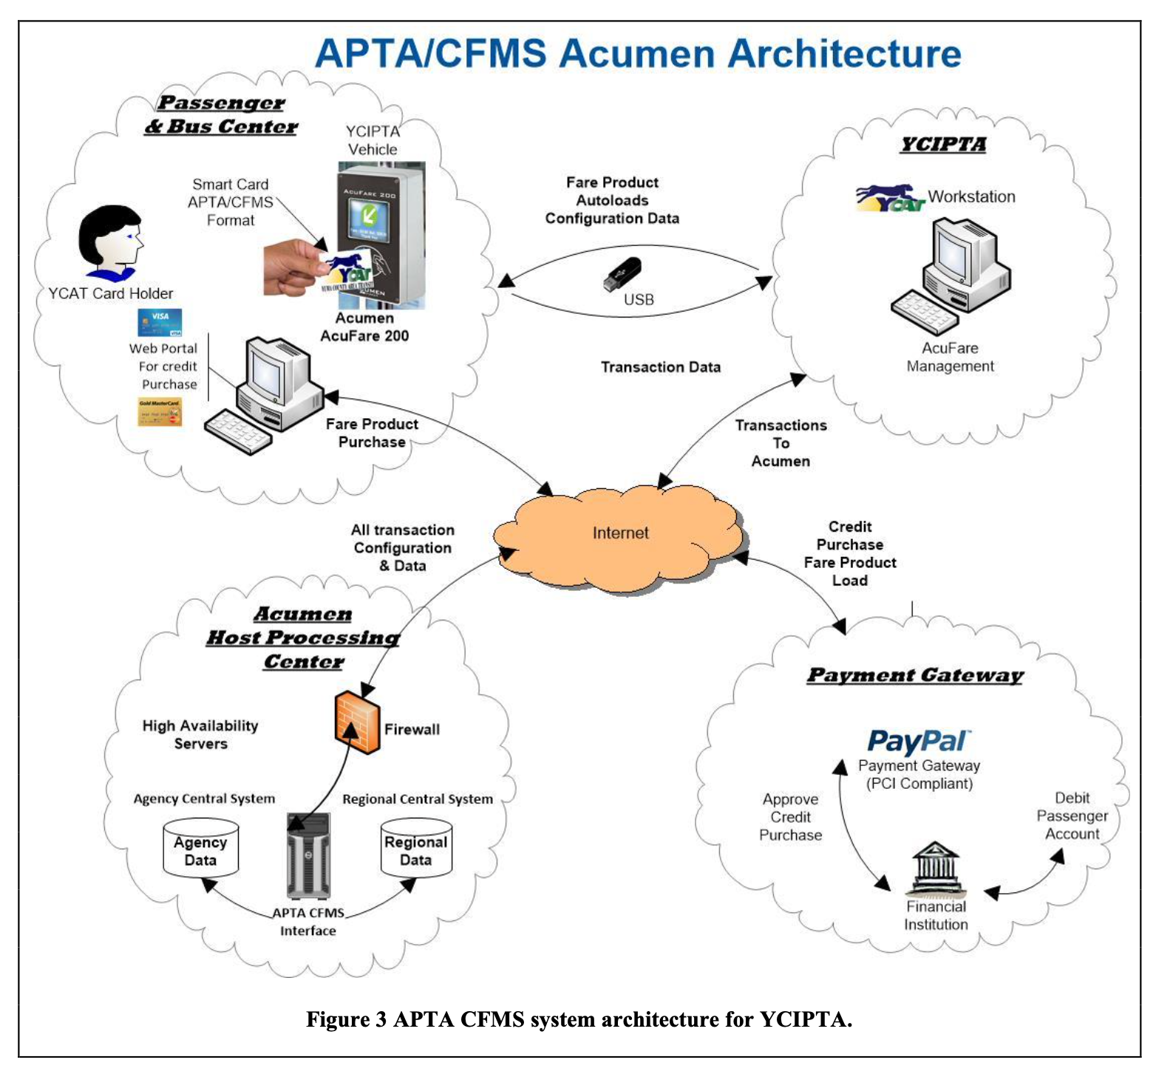
Rural Contactless Fare Payment 2016 Pilot
Acumen consultants worked with Yuma County Intergovernmental Public Transportation Authority (YCIPTA) to implement and conduct a 90-day pilot transit smart card fare payment system
Smart cards compliant with CFMS, with added capability to load cards over the internet using PayPal payment gateway
Official account stored electronically on smart card, with a synchronized copy of account history available on Acumen Host Processing Center computers
Weekly Meeting (10/03/2022)
Hannah DeBruin

Slide 8
Pilot Learning – Passenger Barriers
Passenger training and awareness
Larger agencies might do comprehensive public training, smaller ones rely on less expensive solutions (ie flyers) which don’t encourage fare method switch in the same way
Passenger acceptance of technology/unbanked riders
Limited use cards, fare discounts when paying with smart cards, change fare policy on use of cash
Passenger monetary capability
May simply lack the resources to place transit value on a smart card for an extended period
Internet access limitations, remoteness of YCIPTA headquarters
Point of Sale (POS) terminals in retail establishments
Weekly Meeting (10/03/2022)
Hannah DeBruin

Slide 9
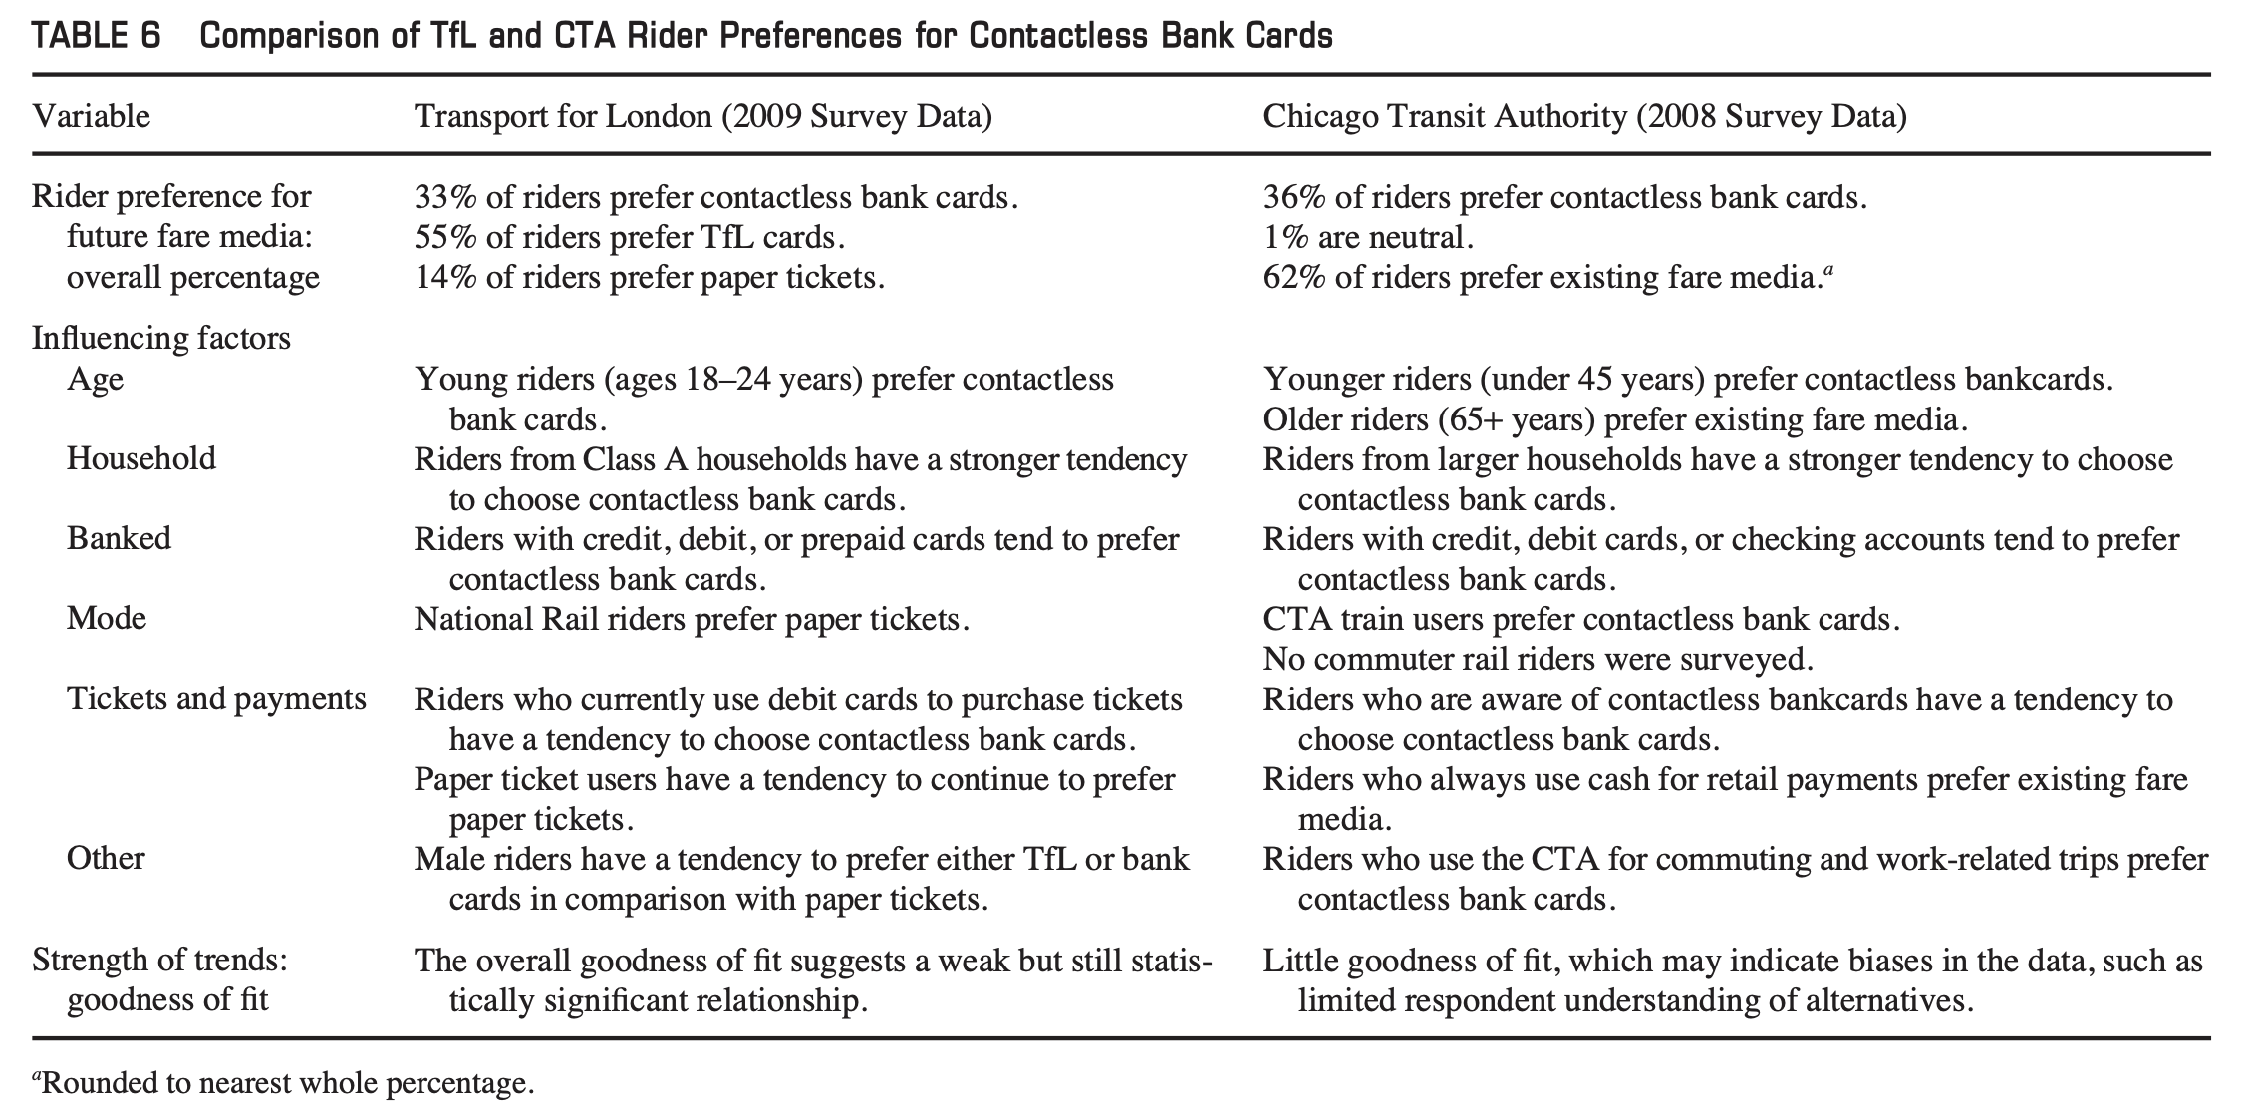
Fare Payment Method Stated Preference London and Chicago -2011
2011 analysis of Chicago Transit Authority and Transport for London riders’ fare payment preferences using stated preference survey and discrete choice models (binary logit for CTA bank card and currency exchange, multinomial for TFL paper ticket, TFL card, and bank card)
“In this analysis, riders who preferred contactless bank cards were generally from younger age groups, and they tended to have access to credit and debit cards… In contrast, those who preferred existing fare media were older in age, and they tended to favor current payment mechanisms (such as cash for retail payments), which may indicate that they approach new payment technologies with skepticism.
Many TFL independent variables were not statistically significant/had weak relationship with fare medium choice. Rho squared 0.187, only t-statistics over 1.55 included in model
Many CTA independent variables were also not statistically significant/had weak relationship with fare medium choice. Rho squared 0.07, only t-statistics over 1.5 included in model
Weekly Meeting (10/03/2022)
Hannah DeBruin

Slide 10
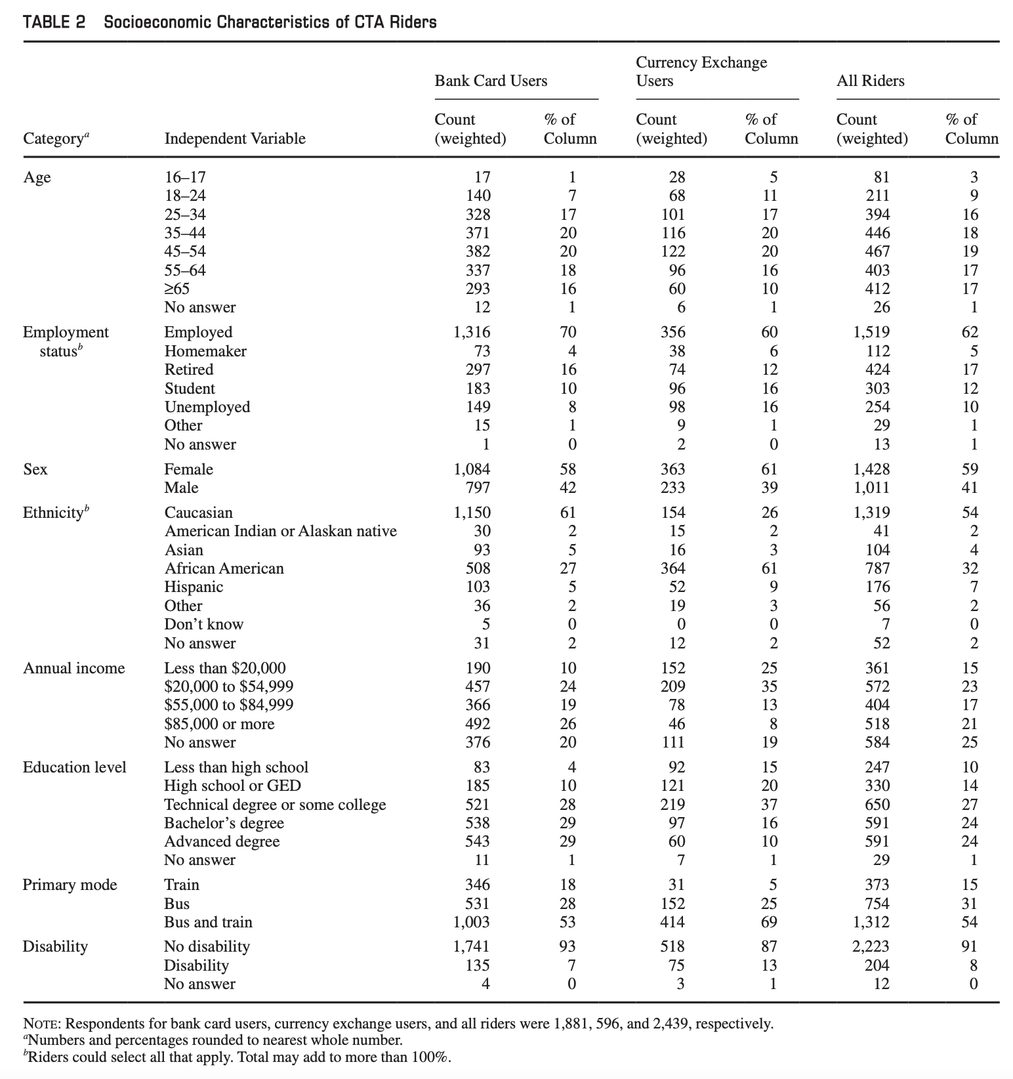
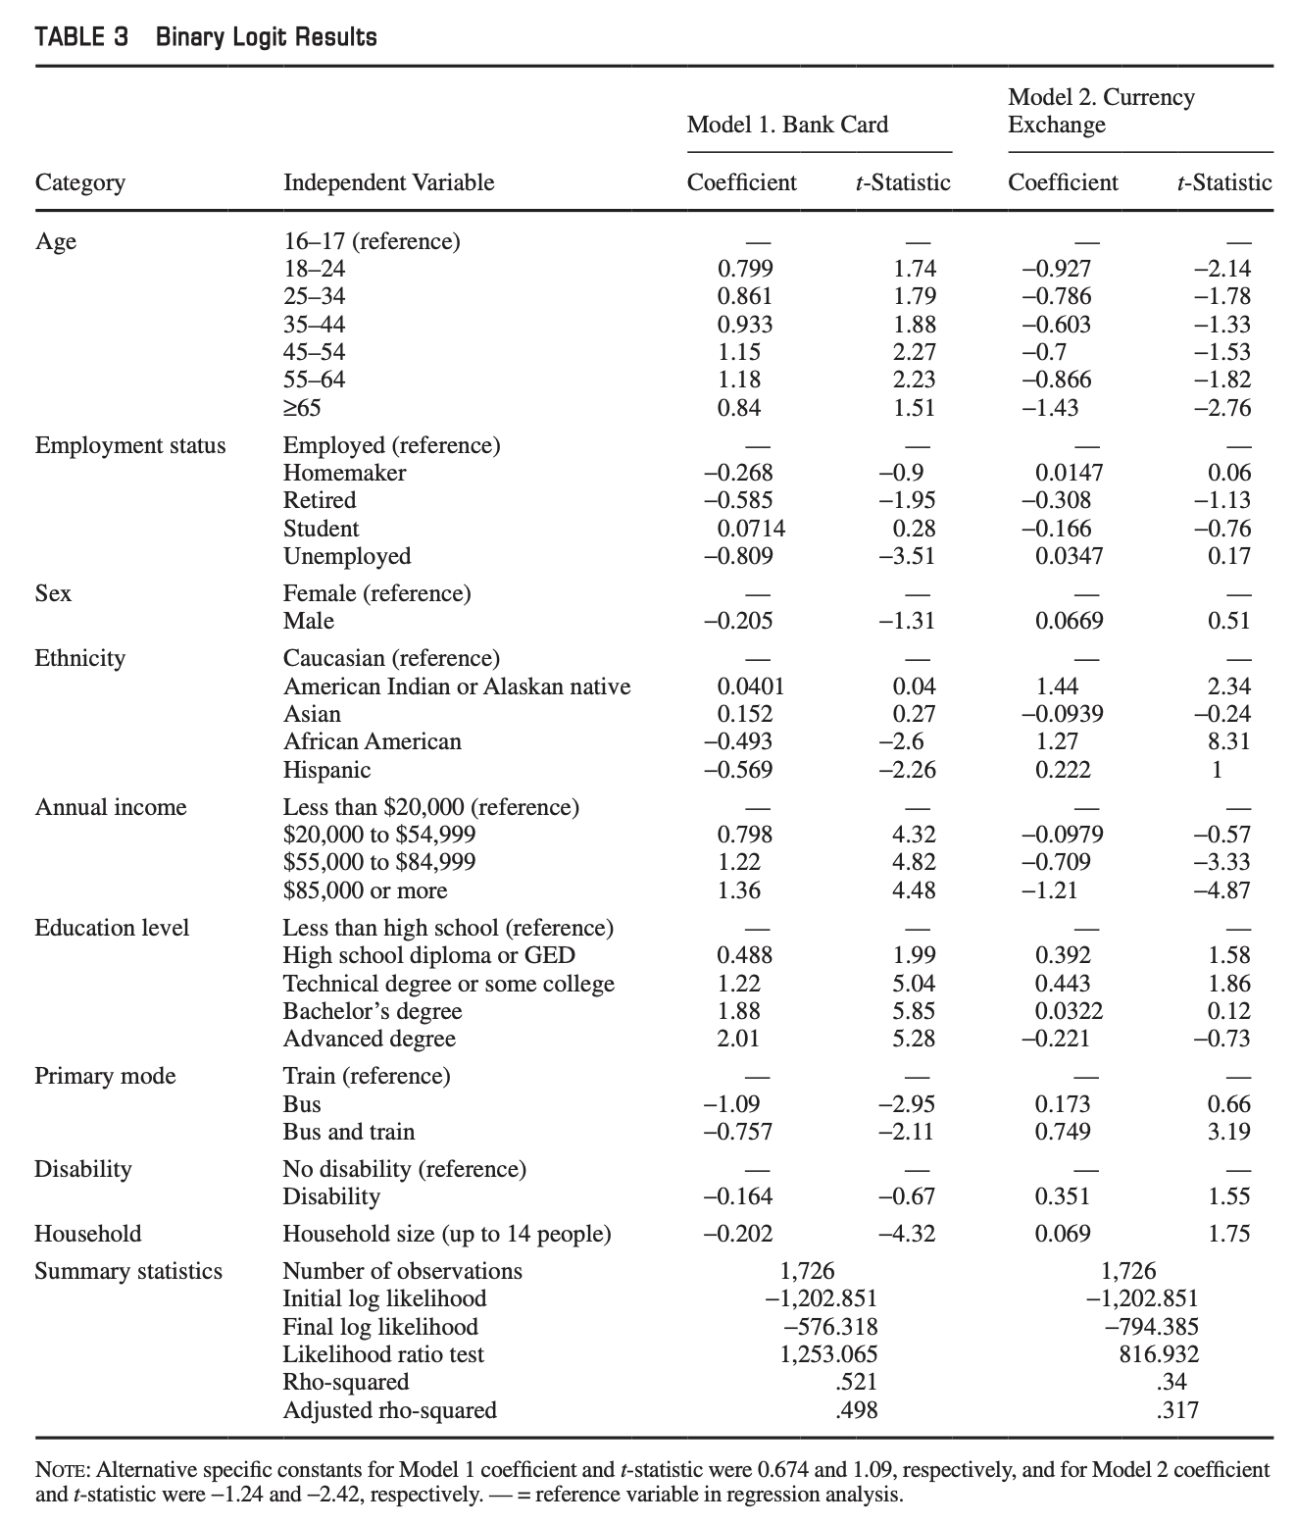
Fare Payment Method “Unbanked”ness and Equity - 2013
2013 analysis of Chicago Transit Authority riders’ fare payment preferences using stated preference survey and discrete choice models (binary logit for bank card use and currency exchange use)
“CTA riders without bank cards tend to have lower incomes, be unemployed, be bus users, and be minorities.”
Weekly Meeting (10/03/2022)
Hannah DeBruin

Slide 11
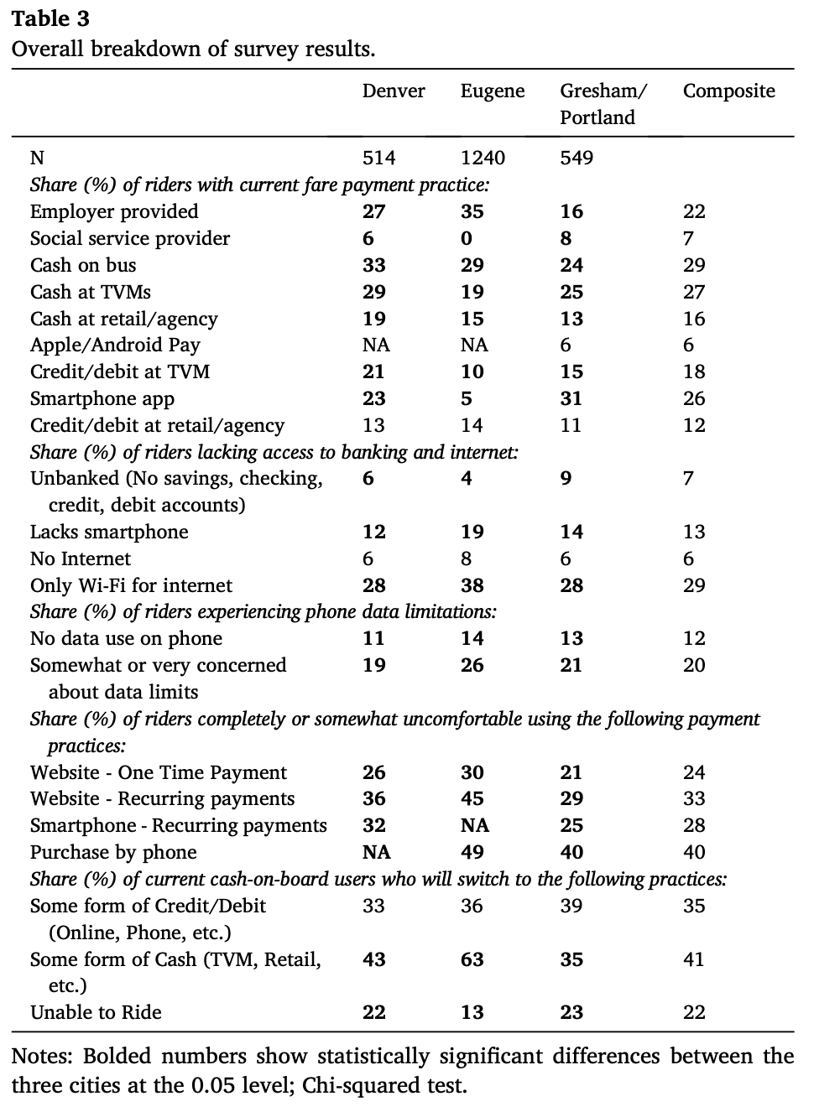
Contactless Fare Payment Survey - 2019
“Focus group findings, in conjunction with the literature, informed a subsequent three-city transit rider intercept survey conducted between July and September 2019; we conducted the transit rider intercept surveys in Portland-Gresham, OR; Eugene, OR; and Denver, CO.
The surveys focused on current fare payment behavior, access to banking, Internet and smartphone resources, and potential fare payment behavior in the absence of cash options. Demographic information was also collected in order to perform an equity analysis.
Transit riders who did not wish to complete the survey at the moment were provided a written envelope and pre-stamped envelope to return the survey by mail. No incentives were given for participation. In total, 2,303 riders completed intercept surveys across the three regions.”
Binary logistic regression
Weekly Meeting (10/03/2022)
Hannah DeBruin

Slide 12
Qualities to Survey
Demographics
Current fare payment practice
Access to banking
Access to the internet, smartphone, concern about data limitations
Comfort level with various payment practices
If system went cashless, which payment method would the rider switch to? (Unable to ride is an option)
Overall satisfaction with fare payment, transit service
Specific concerns with contactless fare payment like data security
Safety perception of contactless payment related to covid-19
Weekly Meeting (10/03/2022)
Hannah DeBruin

Slide 13
More Literature to Look For/Review
Analysis not using binary logit? (Structural Equation Modeling?)
Studies for more rural regions
Surveys since covid-19
Weekly Meeting (10/03/2022)
Hannah DeBruin

